Slide 1
DATA STRUCTURE
Prof. Dr. Md. Rafiqul Islam

Slide 2
CHAPTER 9
SORTING AND SEARCHING

Slide 3
Sorting
To arrange a list of elements (data) in ascending or descending order is called sorting. There are two types of sorting:
  1. Internal Sorting and
  2. External Sorting

Slide 4
Internal sort
SELECTION SORT

Slide 5
Selection Sort [contd.]
Using steps we can write the method as follows.
  Given a list of data. Find out the smallest data from the list. Remember the position/index of the smallest data. Place the smallest in first position and the data of the first position in the position of the smallest data.
  Repeat the process for the list except data in first position, and so on.

Slide 6
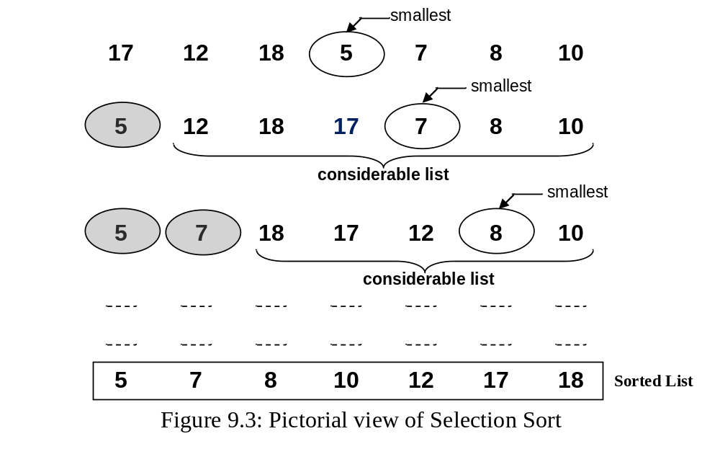

Selection Sort [contd.]

Slide 7
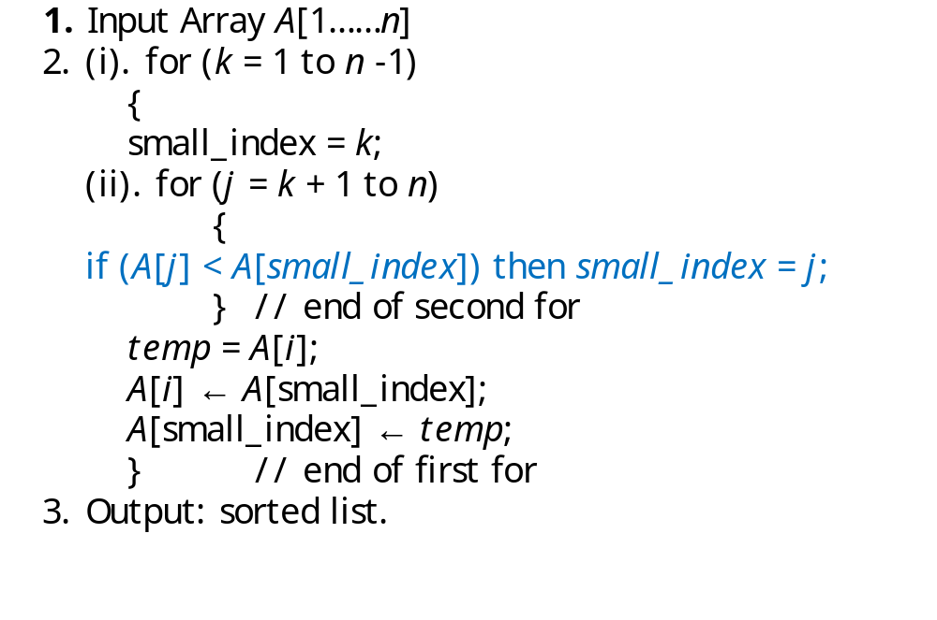
Algorithm for Selection Sort

Slide 8
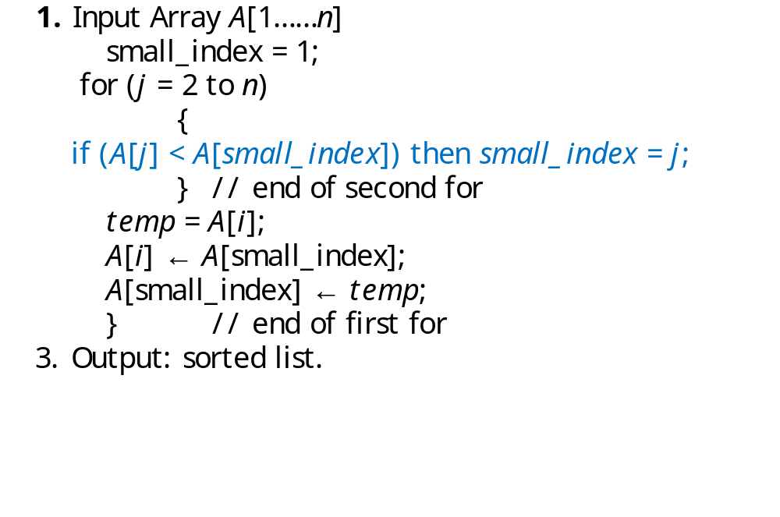
Algorithm to select one smallest and swap

Slide 9
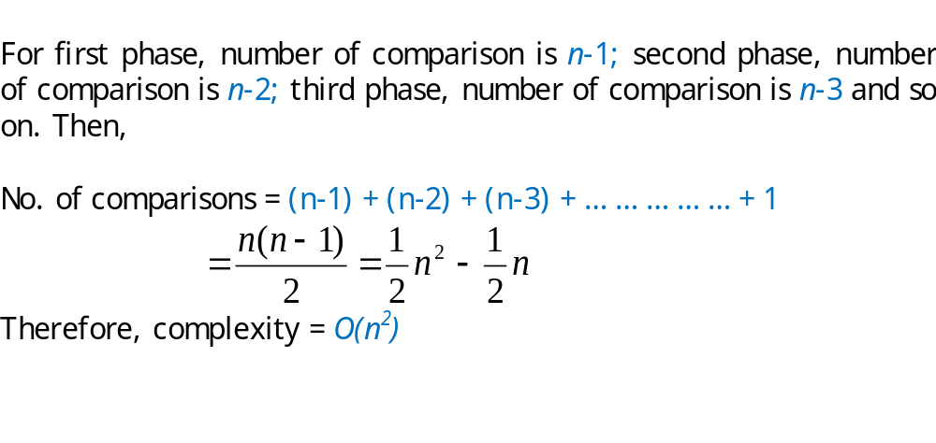
Complexity of selection sort

Slide 10
Internal sort
INSERTION SORT

Slide 11
Insertion Sort [contd.]
Using steps we can describe the process as follows.
  Given a list of elements (data).
  We have to insert a data into its correct position by moving all data (before it) to the right (that are greater than the data which is being considered at this moment).
  By repeating Step-ii for all considerable data we can arrange the whole list in ascending order.

Slide 12
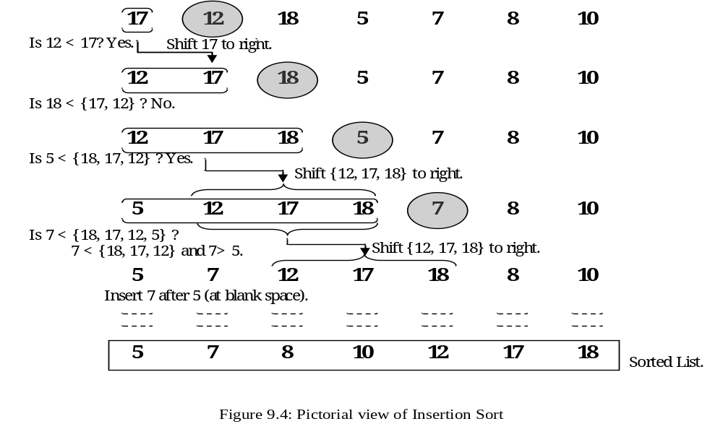
Insertion Sort [contd.]

Slide 13
Example of insertion sort
8
2
4
9
3
6

Slide 14
Example of insertion sort
8
2
4
9
3
6

Slide 15
Example of insertion sort
8
2
4
9
3
6
2
8
4
9
3
6

Slide 16
Example of insertion sort
8
2
4
9
3
6
2
8
4
9
3
6
2
4
8
9
3
6

Slide 17
Example of insertion sort
8
2
4
9
3
6
2
8
4
9
3
6
2
4
8
9
3
6

Slide 18
Example of insertion sort
8
2
4
9
3
6
2
8
4
9
3
6
2
4
8
9
3
6
2
4
8
9
3
6

Slide 19
Example of insertion sort
8
2
4
9
3
6
2
8
4
9
3
6
2
4
8
9
3
6
2
4
8
9
3
6

Slide 20
Example of insertion sort
8
2
4
9
3
6
2
8
4
9
3
6
2
4
8
9
3
6
2
4
8
9
3
6
2
3
4
8
9
6

Slide 21
Example of insertion sort
8
2
4
9
3
6
2
8
4
9
3
6
2
4
8
9
3
6
2
4
8
9
3
6
2
3
4
8
9
6

Slide 22
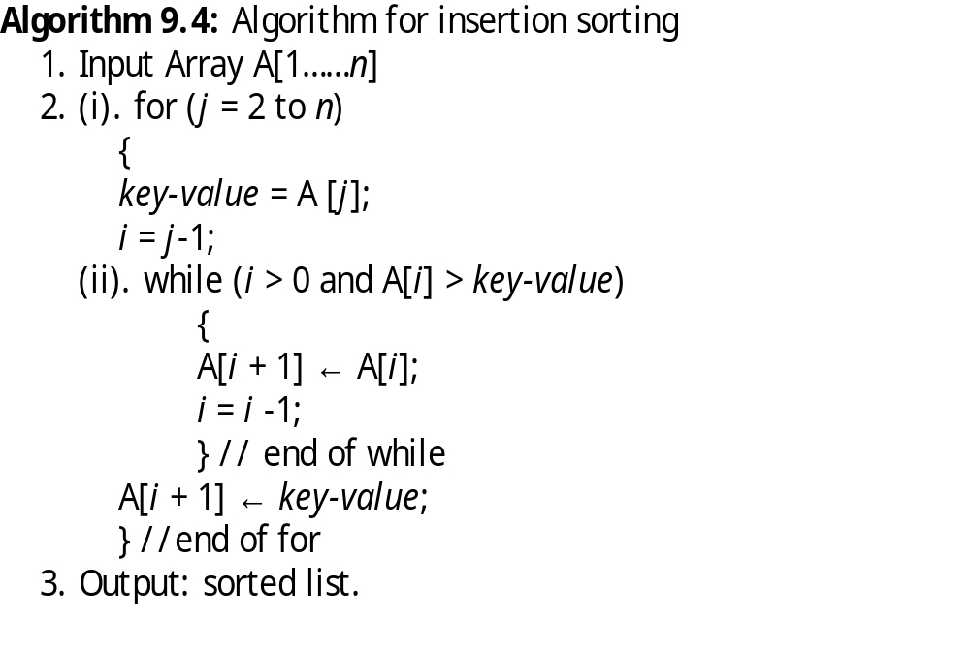
Insertion Sort [contd.]

Slide 23
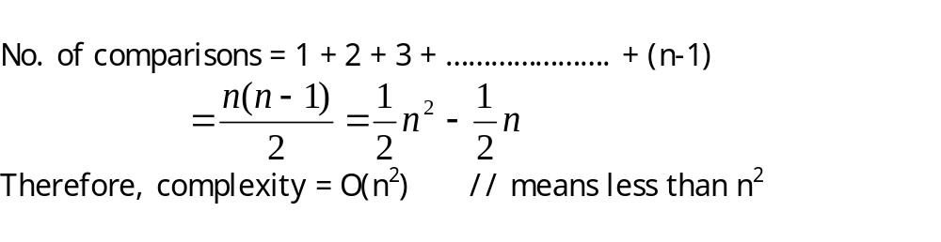
Complexity of Insertion Sort

Slide 24
Summary of Complexities
The complexity of sorting algortihm:
The complexity selection sort is O(n²).
The complexity of insertion sort is O(n²).
The complexity of merge sort O(nlog₂ n) both in average and worst cases.
iv) The complexity of quick sort O(nlog_{e} n) time in average case and O(n²) in worst case .

Slide 25
Searching
Searching means to find out or locate any element from a given list of elements.
To identify or locate an element or position of the element from a list of elements is called searching.
Here we shall study two types of searching
>Linear searching
>Binary Searching

Slide 26
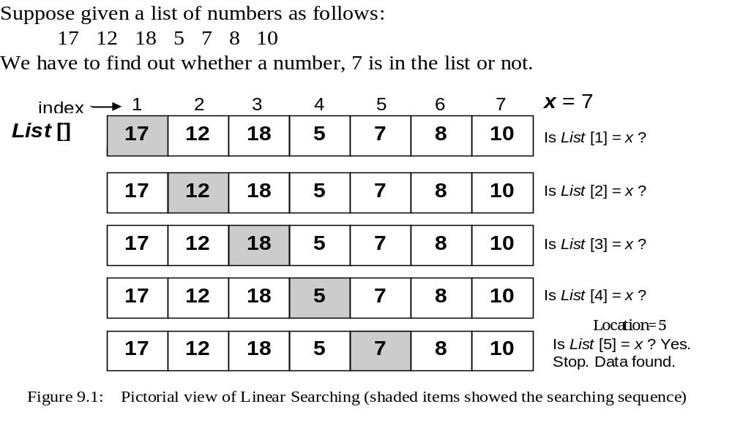
Linear Searching [contd.]

Slide 27
Algorithm for linear searching
  1. Input a list and an item (element to be found)
  A [1…n]; item = x; Location = 0
  2. Search the list to find the target element
  for (i = 1; i ≤ n; i = i + 1)
  {
  if (A[i] = =item)
  {
  print “Found ”;
  location = i
  Stop searching;
  }
  }
  3. if (i > n) print “Not Found ”;
  4. Output : “Found” or “Not Found”.

Slide 28
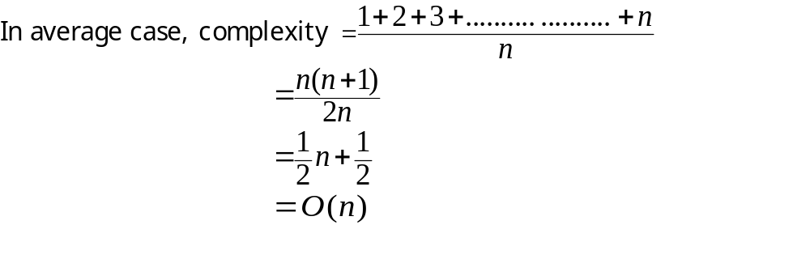
Complexity for linear searching

Slide 29
Binary Searching
prerequisite for binary searching is that the elements must be arranged either in ascending or in descending order.
Problem
  Given list of data elements arranged in ascending or descending order, locate (find the position of) a particular (target) element from the list.
  Remember: It is not Binary Search Tree (BST). BST is a data structure, whereas binary search is a method or technique (not a data structure).

Slide 30
Binary Searching [contd.]
Example:
Suppose we have a list of numbers as follows
17 19 28 30 45 55 58 61 63 67 72 76 80 89 99
And we have to find out 89 from the list
mid = (first + last)/2;

Slide 31
1 2 3 4 5 6 7 8 9 10 11 12 13 14 15
17 19 28 30 45 55 58 61 63 67 72 76 80 89 99
first mid last
9 12 15
17 19 28 30 45 55 58 61 63 67 72 76 80 89 99
first mid last
13 14 15
17 19 28 30 45 55 58 61 63 67 72 76 80 89 99
first mid last
X = 89 Found
index
data

Slide 32
Main operation
A[1….n], x;
first =1; last = n;
mid = (first + last) / 2;
(i) if (x = A[mid]), then print mid; // target element = A[mid]
(ii) else if (x < A[mid]) then last = mid - 1;
(iii) else first = mid +1;

Slide 33
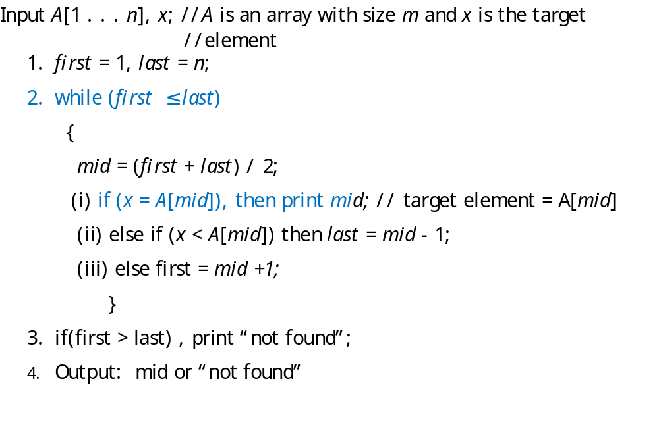
Algorithm for Binary Searching (pseudocode)

Slide 34
Complexity of binary search
Suppose, there are n elements in the list.
Let n = 2^{k}; then k = log₂ n.
Therefore, complexity = O (log₂ n)

Slide 35
Summary of Complexities
The complexity of searching algorithm:
i) The complexity of linear search is O(n).
ii) The complexity of binary search is O(log₂n).

Slide 36
THANK YOU.

